Slide 1

Amazon Sales Data Insights & Recommendations
Business Review Presentation
Uncovering actionable insights from 5,901 transactions to drive strategic growth and profitability optimization

Slide 2
Our Journey Through the Data
01
02
03
Dataset Overview
Sales & Profit Analysis
Regional & Segment Performance
Understanding our foundation
Revenue performance deep dive
Geographic and customer insights
04
05
06
Product Category Analysis
Returns & Payment Analysis
Key Trends & Observations
Category profitability breakdown
Customer behavior patterns
Critical business patterns
07
Actionable Recommendations
Strategic next steps

Slide 3

Dataset Foundation
5.9K
2
Total Transactions
Years Covered
Comprehensive transaction records analyzed
2019-2020 business period
3
3
Customer Segments
Product Categories
Consumer, Corporate, Home Office
Furniture, Technology, Office Supplies
Key Data Fields: Sales revenue, profit margins, quantity sold, return rates, payment methods, regional distribution, and detailed category breakdowns across all customer segments.

Slide 4


Revenue Performance Snapshot
$621K
Total Sales Revenue
Strong overall performance across all categories and regions
$70K
Total Profit Generated
Healthy profit margins with room for optimization
Key Insight: Technology drives the highest sales volume, but Office Supplies deliver superior profit margins. This presents a strategic opportunity for portfolio rebalancing.
Strategic Focus: Scale high-margin Office Supplies while optimizing Technology cost structure to maximize profitability without sacrificing market share.

Slide 5
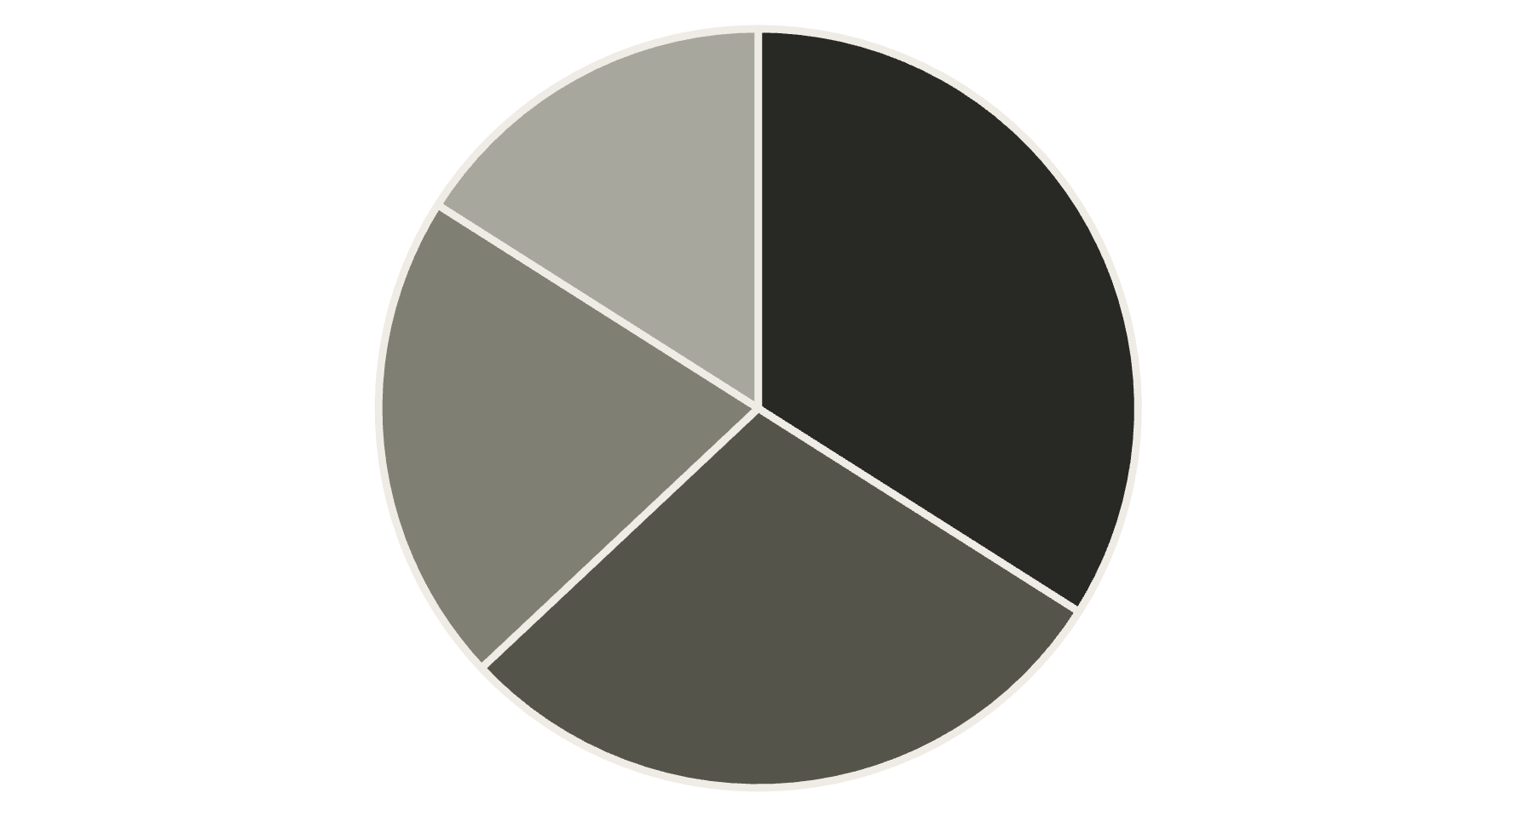



Geographic & Customer Performance
Regional Distribution
Customer Segments
52%
Consumer
Largest market segment
30%
West
East
Central
South
Corporate
Business customers
18%
Home Office
Remote work segment
Strengthen Central Region
Consumer Loyalty Programs
Implement better pricing strategies and supply-chain optimization to capture untapped market potential
Design targeted retention programs for our largest segment to maintain and grow market share

Slide 6




Product Portfolio Deep Dive
Category Performance Ranking
Office Supplies
Highest sales volume and strong margins
Furniture
Moderate sales with profitability challenges
Technology
High volume, margin optimization needed
Loss Leaders
Top Performers
Bookcases (negative margins)
Phones (strong demand)
Tables (minimal profitability)
Accessories (high margins)
Large furniture items
Storage solutions (consistent sales)
Strategic opportunity: Reduce discounts on loss-making Furniture items while expanding our phones and accessories portfolio with attractive bundled offers.

Slide 7


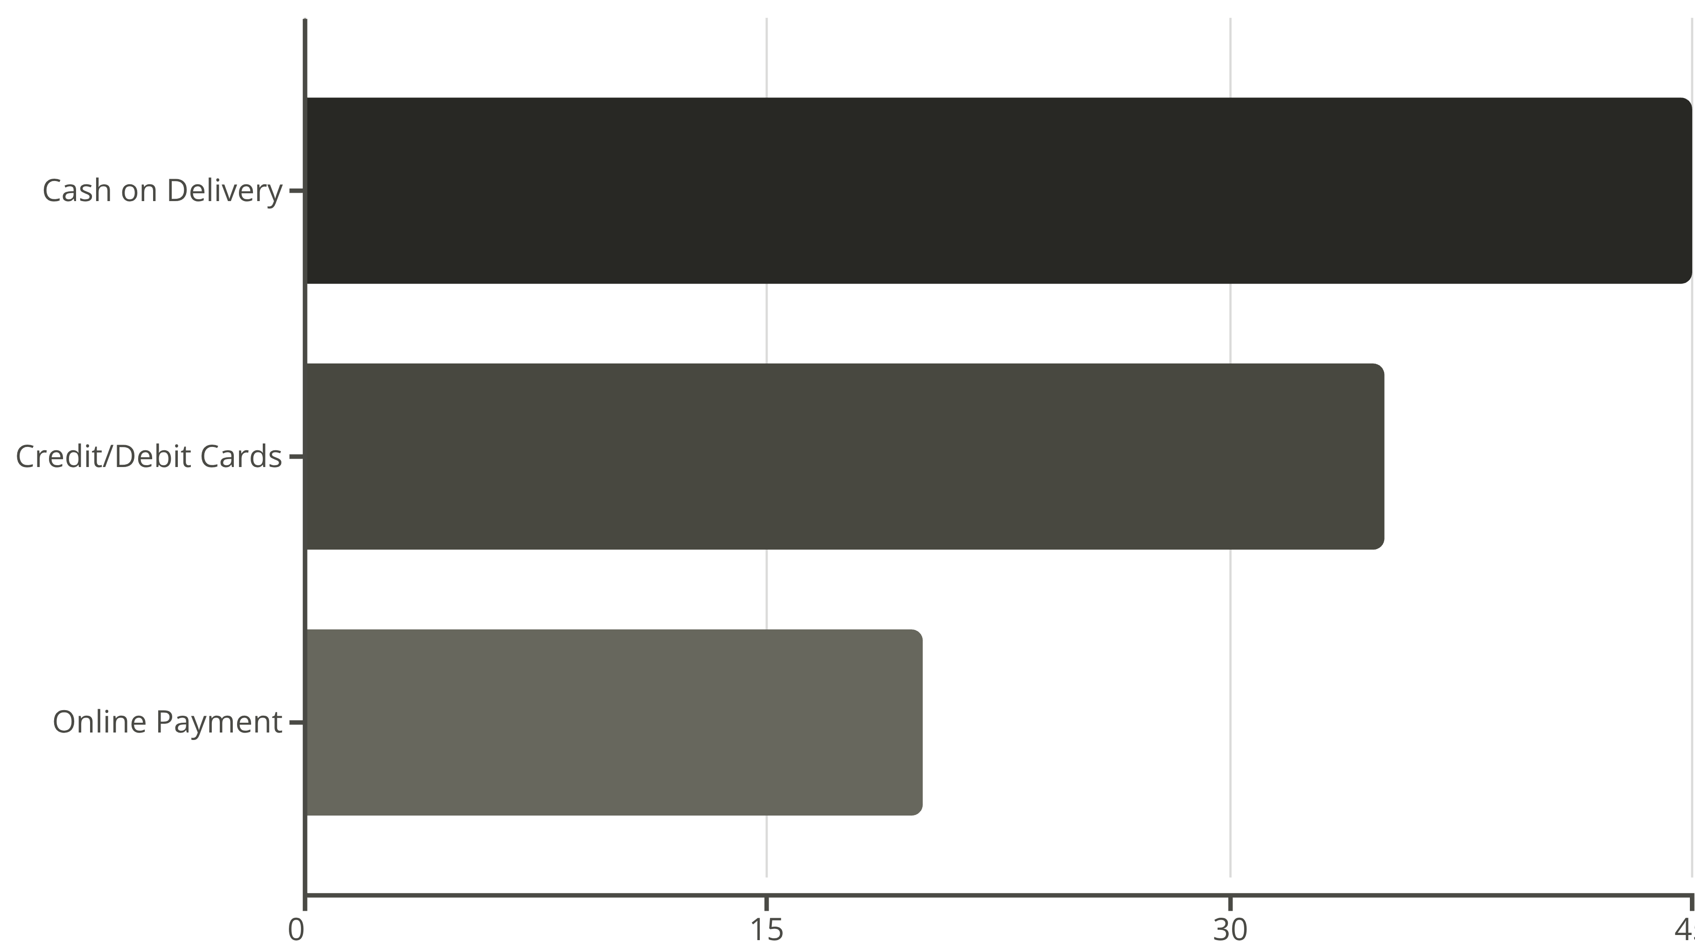
Customer Behavior & Payment Insights
Return Rate
Payment Preferences
3% of total orders
COD dominates
Higher concentration in Furniture category due to size and quality issues
Cash on delivery leads, followed by cards and online payments
Payment Method Distribution
Improve Furniture Quality Control
Build Online Payment Trust
Enhanced product descriptions and quality checks to reduce return rates
Easy refund policies and secure payment gateways to encourage digital adoption

Slide 8


Critical Business Patterns
1
Q4 Sales Peak
Holiday season drives significant revenue spikes across all categories
2
Technology Growth
Rising demand in tech products with evolving consumer preferences
3
Furniture Challenges
Persistent profitability issues requiring strategic intervention
4
East Region Dominance
Leading performance in both sales volume and profit contribution
Return Pattern Analysis
Returns are predominantly linked to bulky items including Furniture, Tables, and Bookcases. This correlation suggests logistical and quality perception challenges that impact customer satisfaction.
The pattern indicates opportunities for improved packaging, delivery processes, and customer expectation management.

Slide 9
Strategic Action Plan
1
Optimize Product Portfolio
Reduce low-profit Furniture SKUs while expanding Technology and Office Supplies offerings to maximize overall profitability
2
Region-Specific Strategy
Boost Central region performance through targeted marketing campaigns and supply chain optimization initiatives
3
Enhanced Customer Engagement
Develop loyalty programs for Consumer segment and create attractive bundled offers for Technology products
4
Operational Excellence
Implement improved quality checks and enhanced product descriptions to reduce Furniture return rates
5
Digital Transformation Push
Leverage online channels with targeted promotions and seamless refund policies to build customer trust

Slide 10
Moving Forward with Confidence
Amazon's sales foundation is strong, but strategic profitability optimization across categories and regions will unlock our next level of growth.
Data-Driven Decision Making
Phased Implementation
Our comprehensive analysis reveals clear opportunities for margin improvement and customer retention enhancement
Pilot targeted strategies in Q1 2021, monitor performance metrics, and scale successful interventions systematically
Next Steps Timeline
Month 1-2: Launch pilot programs in Central region and Consumer loyalty initiatives
Month 3-4: Monitor performance metrics and refine strategies based on early results
Month 5-6: Scale successful interventions across all regions and segments

